Slide 1
Week 1

Slide 2
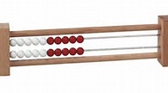
Math Corner
Using your Rekenek, build the number 12 in as many ways as you can. Write you ideas in your Math Journal.

Slide 3

Math Corner-
There are ten Angry Birds outside . How can you figure out the number of legs there are altogether?

Slide 4

Math Corner-
How many legs are there on two penguins? Draw a picture to solve.

Slide 5

Math Corner-
How many toes are there on three feet? Explain your thinking.
Yesterday, you were 5th in line for the bathroom. Draw a picture and put an X over your spot in the line if there are ten people in line.

Slide 6
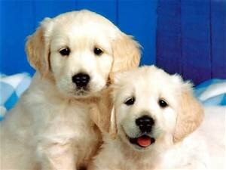
Math Corner
There are 2 puppies in the yard. More come to join them and now there are 5. How many puppies joined the 2 puppies?
Review: Write the numerals 20 to 1.

Slide 7
Week 2

Slide 8
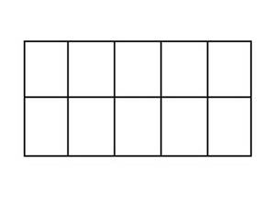
Math Corner
Draw a ten frame. Put a circle in 4 squares. Is this number closer to 5 or closer to 10? Explain your thinking.
Draw a ten frame. Put a circle in eight squares. Is this number closer to 5 or closer to 10? Explain your thinking.

Slide 9

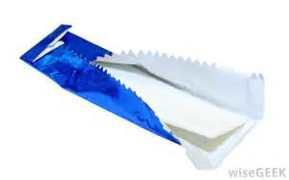
Math Corner
Sally has some pennies to buy a pack of gum for 7 pennies and a toy for 8 pennies. How much did she have to pay? Use picture, numbers, or words to explain your thinking.
The problem is 7 + 3. Solve it as many different ways as you can using MENTAL OR REKENREK.

Slide 10

Math Corner
Use your Rekenrek. Draw as many combinations of 17 as you can. Write your number sentences in your Math Journal.
Think Space!
The number is 10. Build it as many different ways as you can using MENTAL OR REKENREK.

Slide 11
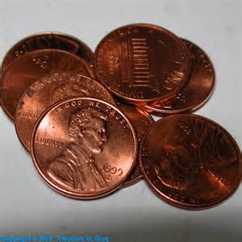
Math Math Corner
Ms. Holmes has 2 pennies. Ms. Mitchell has 2 pennies. Ms. Fluker has 1 penny. Draw two ten-frames to help you find out how much they have altogether. Write a number sentence to show your thinking.
Think Space!
The problem is 8 + 2. Solve it as many different ways as you can using MENTAL OR REKENREK.

Slide 12
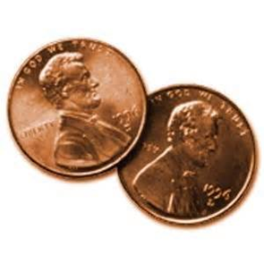
Math Corner
Hannah has two pennies. How many more does she need to fill a ten-frame? Draw a picture to show your thinking.
Think Space!
The number is 14. Build it as many different ways as you can using MENTAL THINKING OR a REKENREK.

Slide 13
Week 3

Slide 14
Math Corner
Make a tally table of
today’s lunch choices.
How can you use pictures to match your tally table?

Slide 15
Math Corner
Survey your class to find out who likes dogs, cats, birds, and fish the most. Create a class sort of your data.

Slide 16

Math Corner
How many fingers on six hands? Tell with numbers and words.

Slide 17

Math Corner
You were given 5 pieces of candy and your friend was given 8 pieces.
Draw a picture of your candy and your friend’s candy.
Circle the larger group of candy.
Tell how many pieces you both have altogether.

Slide 18
Math Corner
1. Make a tally table of the number of girls and boys in your class.
2. Use your data to create a picture graph.
3. Write a number sentence to explain the total number of boys and girls in your class.

Slide 19
Week 4

Slide 20
Math Corner
Ray looks at the weather each day at noon. The table shows the kind of weather Ray saw each day.
Part A
How many snowy days did Ray see?
Part B
How many sunny days did Ray see?
Part C
How many days in all did Ray look at the weather? Show your work.

Slide 21

Math Corner-Tuesday
Cathy has six stickers in her coin collection book. 5 stickers fell out of her book. How many stickers does she have now?
Think Space!
The problem is 7 - 5. Solve it as many different ways as you can using MENTAL OR REKENREK.

Slide 22
Math Corner
Create a story problem for 4+1.
Explain your thinking and draw a picture to solve the problem.
Think Space!
The problem is 2 + 3. Solve it as many different ways as you can using MENTAL OR REKENREK

Slide 23
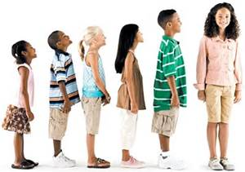
Math Corner
You are in line for the bathroom and there are three people in front of you. What place are you in line?
Think Space!
The problem is 11 - 5. Solve it as many different ways as you can using MENTAL OR REKENREK.

Slide 24
Math Corner
Ms. Inman has 18 students. 10 of them are girls. How many are boys? Solve with pictures, numbers, and words.

Slide 25
Math Corner
Yesterday, you were 8th in line for the bathroom. Draw a picture and put an X over your spot in the line if there are ten people in line.
.

Slide 26
Week 5

Slide 27

Math Corner
If you were to combine the two sets of balls below, how many would you have? Draw a picture and write a number sentence to explain your thinking.

Slide 28
Math Corner
Draw two ten-frames. Draw 12 triangles in the ten-frames . How many squares do not have triangles? Explain your thinking.

Slide 29

Math Corner-Tuesday
Your teacher has nine pencils. She would like to give you and two of your friends an equal amount of pencils. Draw a picture showing how this can be done.
Think Space!
Build the number 16 as many different ways as you can using MENTAL MATH OR YOUR REKENREK.

Slide 30
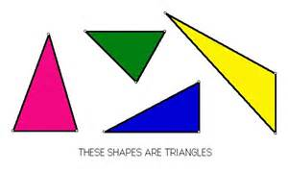
Math Corner
Draw 15 triangles. How many more are needed to fill two ten-frames? Explain your thinking.
.

Slide 31
Math Corner
Ray looks at the weather each day at noon. The table shows the kind of weather Ray saw each day.
Part A
How many snowy and rainy days were there?
Part B
How many snowy and sunny days were there?
Part C
Create a pictograph to represent this data.

